Slide 1
Closest Pair Of Points
Given n points in 2D, find the pair that are closest.

Slide 2
Applications
We plan to drill holes in a metal sheet.
If the holes are too close, the sheet will tear during drilling.
Verify that no two holes are closer than a threshold distance (e.g., holes are at least 1 inch apart).

Slide 3

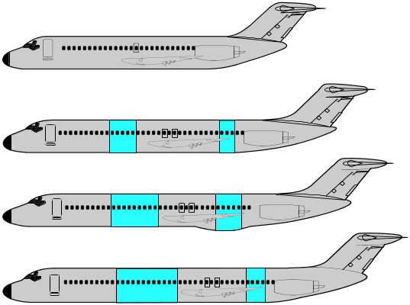

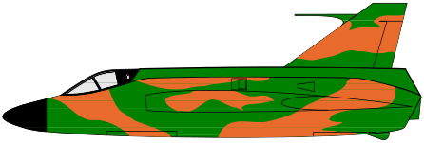
Air Traffic Control
3D -- Locations of airplanes flying in the neighborhood of a busy airport are known.
Want to be sure that no two planes get closer than a given threshold distance.

Slide 4
Simple Solution
For each of the n(n-1)/2 pairs of points, determine the distance between the points in the pair.
Determine the pair with the minimum distance.
O(n²) time.

Slide 5
Divide-And-Conquer Solution
When n is small, use simple solution.
When n is large
  Divide the point set into two roughly equal parts A and B.
  Determine the closest pair of points in A.
  Determine the closest pair of points in B.
  Determine the closest pair of points such that one point is in A and the other in B.
  From the three closest pairs computed, select the one with least distance.
Notes:
Algorithm doesn’t actually find closest pair with 1 point in A and other in B. Rather, it does this only if such a pair is the closest overall pair!

Slide 6
Example
A
B
Divide so that points in A have x-coordinate <= that of points in B.

Slide 7
Example
d₁
A
B
Find closest pair in A.
Let d₁ be the distance between the points in this pair.

Slide 8
Example
d₁
d₂
A
B
Find closest pair in B.
Let d₂ be the distance between the points in this pair.

Slide 9
Example
d₁
d₂
A
B
Let d = min{d₁, d₂}.
Is there a pair with one point in A, the other in B and distance < d?

Slide 10
Example
A
R_{A}
R_{B}
B
Candidates lie within d of the dividing line.
Call these regions R_{A} and R_{B}, respectively.

Slide 11
Example
q
A
R_{A}
R_{B}
B
Let q be a point in R_{A}.
q need be paired only with those points in R_{B} that are within d of q.y.

Slide 12
Example
2d
q
d
A
R_{A}
R_{B}
B
Points that are to be paired with q are in a d x 2d rectangle of R_{B} (comparing region of q).
Points in this rectangle are at least d apart.

Slide 13
Example
2d
q
d
A
R_{A}
R_{B}
B
So the comparing region of q has at most 6 points.
So number of pairs to check is <= 6| R_{A} | = O(n).

Slide 14

Time Complexity
Create a sorted by x-coordinate list of points.
  O(n log n) time.
Create a sorted by y-coordinate list of points.
  O(n log n) time.
Using these two lists, the required pairs of points from R_{A} and R_{B} can be constructed in O(n) time.
Let n < 4 define a small instance.

Slide 15
Time Complexity
Let t(n) be the time to find the closest pair (excluding the time to create the two sorted lists).
t(n) = c, n < 4, where c is a constant.
When n >= 4,
  t(n) = t(ceil(n/2)) + t(floor(n/2)) + an,
  where a is a constant.
To solve the recurrence, assume n is a power of 2 and use repeated substitution.
t(n) = O(n log n).
Notes:
When you add in the initial sort time for the sort by x and sort by y lists, the overall time remains O(n log n).

